Slide 1
Artificial Neural Networks

Slide 2
Introduction To Artificial Neural Networks
ANN are a promising new generation of Information processing systems that demonstrate the ability to learn, recall & generalize from training patterns or data
ANNs are systems that are deliberately constructed to make use of some organizational principles resembling those of human brain
ANNs are inspired by modeling networks of biological neurons in the brain

Slide 3
Biological Motivation
Human brain is a densely interconnected network of approximately 10¹¹ neurons, each connected to, on average, 10⁴ others.
Neuron activity is excited or inhibited through connections to other neurons.
The fastest neuron switching times are known to be on the order of 10⁻³ sec.

Slide 4

Principles of Brain Processing
How our brain manipulates with patterns ?
A process of pattern recognition and pattern manipulation is based on:
Connectionism
Brain computer is a highly interconnected neurons system in such a way that the state of one neuron affects the potential of the large number of other neurons which are connected according to weights or strength. The key idea of such principle is the functional capacity of biological neural nets determs mostly not so of a single neuron but of its connections
Associative distributed memory
Storage of information in a brain is supposed to be concentrated in synaptic connections of brain neural network, or more precisely, in the pattern of these connections and strengths (weights) of the synaptic connections.
Massive parallelism
Brain computer as an information or signal processing system, is composed of a large number of a simple processing elements, called neurons. These neurons are interconnected by numerous direct links, which are called connection, and cooperate which other to perform a parallel distributed processing (PDP) in order to soft a desired computation tasks.

Slide 5


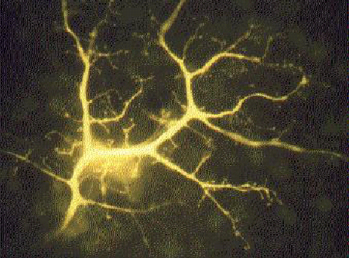
Brain Computer: What is it?
Human brain contains a massively interconnected net of 10¹⁰-10¹¹ (10 billion) neurons (cortical cells)
Biological Neuron
- The simple “arithmetic computing” element

Slide 6
Biological Neurons
Soma or body cell - is a large, round central body in which almost all the logical functions of the neuron are realized.
The axon (output), is a nerve fibre attached to the soma which can serve as a final output channel of the neuron. An axon is usually highly branched.
The dendrites (inputs)- represent a highly branching tree of fibres. These long irregularly shaped nerve fibres (processes) are attached to the soma.
Synapses are specialized contacts on a neuron which are the termination points for the axons from other neurons.
Synapses
Axon from other neuron
Soma
Dendrite from other
Axon
Dendrites
The schematic model of a biological neuron

Slide 7
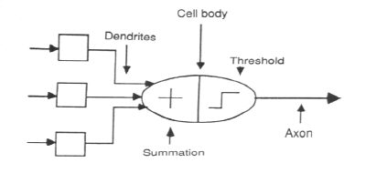
ASSOCIATION OF BIOLOGICAL NET
WITH ARTIFICIAL NET

Slide 8
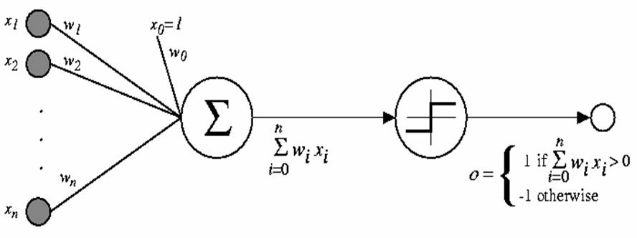
Schematic diagram of McCulloch & Pitts Neuron
In this model, the i^{th} processing element computes a weighted sum of its inputs and outputs 1 (firing) or 0 (not firing) according to whether this weighted input sum is above or below a certain threshold θ_{i}

Slide 9
DEFINITION OF NEURAL NETWORKS
According to the DARPA Neural Network Study
(1988, AFCEA International Press, p. 60):
• ... a neural network is a system composed of
many simple processing elements operating in
parallel whose function is determined by network
structure, connection strengths, and the
processing performed at computing elements or
nodes.

Slide 10
According to Haykin (1994), p. 2:
• A neural network is a massively parallel
distributed processor that has a natural
propensity for storing experiential knowledge
and making it available for use. It resembles
the brain in two respects:
– Knowledge is acquired by the network through a learning process.
– Inter-neuron connection strengths known as synaptic weights are used to store the knowledge.

Slide 11
Background and Motivation
History of Artificial Neural Networks
Creation:
1890: William James - defined a neuronal process of learning
Promising Technology:
1943: McCulloch and Pitts - earliest mathematical models
1954: Hebb and IBM research group - earliest simulations
1958: Frank Rosenblatt - The Perceptron
Disenchantment:
1969: Minsky and Papert - perceptrons have severe limitations
Re-emergence:
1985: Multi-layer nets that use back-propagation
1986: PDP Research Group - multi-disciplined approach

Slide 12
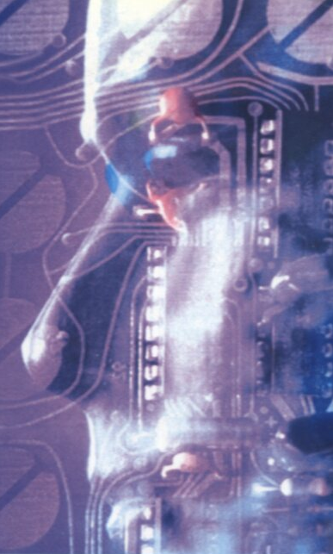
Brain-like Computer
Artificial Neural Network – Mathematical Paradigms of Brain-Like Computer
The new paradigm of computing mathematics consists of the combination of such artificial neurons into some artificial neuron net.
Neurons and Neural Net
Brain-Like Computer
Brain-like computer –
is a mathematical model of humane-brain principles of computations. This computer consists of those elements which can be called the biological neuron prototypes, which are interconnected by direct links called connections and which cooperate to perform parallel distributed processing (PDP) in order to solve a desired computational task.
?

Slide 13
ANN as a Brain-Like Computer
NN as an model of brain-like Computer
An artificial neural network (ANN) is a massively parallel distributed processor that has a natural propensity for storing experimental knowledge and making it available for use. It means that:
Knowledge is acquired by the network through a learning (training) process;
The strength of the interconnections between neurons is implemented by means of the synaptic weights used to store the knowledge.
The learning process is a procedure of the adapting the weights with a learning algorithm in order to capture the knowledge. On more mathematically, the aim of the learning process is to map a given relation between inputs and output (outputs) of the network.
Brain
The human brain is still not well understood and indeed its behavior is very complex!
There are about 10 billion neurons in the human cortex and 60 trillion synapses of connections
The brain is a highly complex, nonlinear and parallel computer (information-processing system)

Slide 14
Applications of Artificial Neural Networks
Intelligent Control
Advance Robotics
Technical Diagnistics
Machine Vision
Intelligent
Data Analysis
and Signal Processing
Artificial Intellect with Neural Networks
Image & Pattern Recognition
Intelligent Expert Systems
Intelligentl Medicine Devices
Intelligent Security Systems

Slide 15
Why neural network?
- unknown multi-factor decision rule
Learning process using a representative learning set
- a set of weighting vectors is the result of the learning process
- a partially defined function, which is an approximation of the decision rule function

Slide 16
Mathematical Interpretation of Classification in Decision Making
1. Quantization of pattern space into p decision classes
x_{i}
y_{i}
m₁
m₂
m_{p}
m₃
2. Mathematical model of quantization:
“Learning by Examples”
Input Patterns
Response:

Slide 17
Artificial Neuron
A neuron has a set of n synapses associated to the inputs. Each of them is characterized by a weight .
A signal at the i^{th} input is multiplied (weighted) by the weight
The weighted input signals are summed. Thus, a linear combination of the input signals is obtained. A "free weight" (or bias) , which does not correspond to any input, is added to this linear combination and this forms a weighted sum .
A nonlinear activation function φ is applied to the weighted sum. A value of the activation function is the neuron's output.
x₁
w₁
x₂
y
w₂
x_{n}
w_{n}

Slide 18
A Neuron
f is a function to be earned
are the inputs
φ is the activation function
Z is the weighted sum

Slide 19
A Neuron
Neurons’ functionality is determined by the nature of its activation function, its main properties, its plasticity and flexibility, its ability to approximate a function to be learned

Slide 20
BUILDING BLOCKS OF ARTIFICIAL
NEURAL NET
Network Architecture (Connection between Neurons)
Setting the Weights (Training)
Activation Function

Slide 21
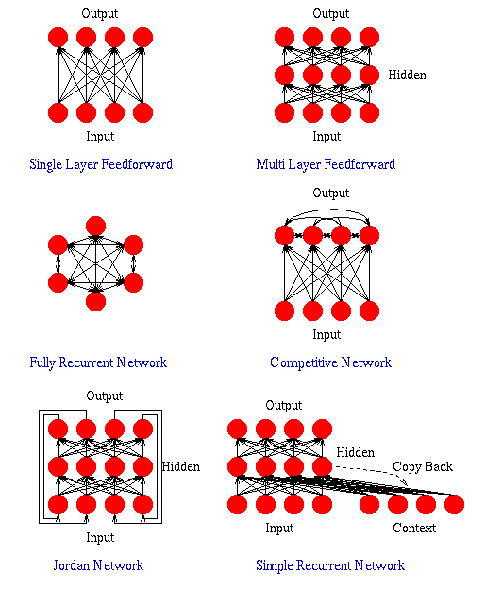

Slide 22
LAYER PROPERTIES
Input Layer: Each input unit may be designated by an attribute value possessed by the instance.
Hidden Layer: Not directly observable, provides nonlinearities for the network.
Output Layer: Encodes possible values.

Slide 23
TRAINING PROCESS
Supervised Training - Providing the network with a series of sample inputs and comparing the output with the expected responses.
Unsupervised Training - Most similar input vector is assigned to the same output unit.
Reinforcement Training - Right answer is not provided but indication of whether ‘right’ or ‘wrong’ is provided.
Gradient descent learning – This is based on the minimization of error E defined in terms of weights & the activation function of the network.
Competitive learning – Here, those neurons which respond strongly to input stimuli have their weights updated. When an input pattern is presented, all neurons in the layer compete & the winning neuron undergoes weight adjustment.

Slide 24
Different types of Learning Rules
Supervised learning
X
Unsupervised learning
X
Reinforcement learning
ANN
W
Y (Actual Output)
Error Signals
Error Signal Generator
D (Desired Output)
ANN
W
Y (Actual Output)

Slide 25
ACTIVATION FUNCTION
ACTIVATION LEVEL – DISCRETE OR
CONTINUOUS
HARD LIMIT FUCNTION (DISCRETE)
Binary Activation function
Bipolar activation function
Identity function
SIGMOIDAL ACTIVATION FUNCTION (CONTINUOUS)
Binary Sigmoidal activation function
Bipolar Sigmoidal activation function

Slide 26
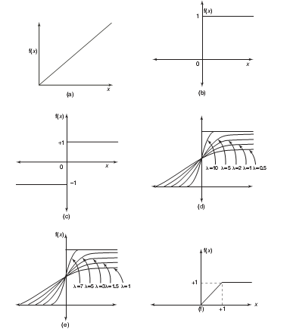
ACTIVATION FUNCTION
Activation functions:
(A)Identity
(B)Binary step
(C)Bipolar step
(D)Binary sigmoidal
(E)Bipolar sigmoidal
(F)Ramp

Slide 27
CONSTRUCTING ANN
Determine the network properties:
Network topology
Types of connectivity
Order of connections
Weight range
Determine the node properties:
Activation range
Determine the system dynamics
Weight initialization scheme
Activation – calculating formula
Learning rule

Slide 28
Principles of Neurocomputing
Connectionizm
NN is a highly interconnected structure in such a way that the state of one neuron affects the potential of the large number of another neurons to which it is connected accordiny to weights of connections
Not Programming but Training
NN is trained rather than programmed to perform the given task since it is difficult to separate the hardware and software in the structure. We program not solution of tasks but ability of learning to solve the tasks
Y
A
Distributed Memory
NN presents an distributed memory so that changing-adaptation of synapse can take place everywhere in the structure of the network.

Slide 29

Principles of Neurocomputing
A
Learning and Adaptation
NN are capable to adapt themselves (the synapses connections between units) to special environmental conditions by changing their structure or strengths connections.
A
Non-Linear Functionality
Every new states of a neuron is a nonlinear function of the input pattern created by the firing nonlinear activity of the other neurons.
Robustness of Assosiativity
NN states are characterized by high robustness or insensitivity to noisy and fuzzy of input data owing to use of a highly redundance distributed structure

Slide 30
Learning Algorithm
Learning algorithm consists of the sequential checking for all vectors from a learning set, whether their membership is recognized correctly. If so, no action is required. If not, a learning rule must be applied to adjust the weights.
This iterative process has to continue either until for all vectors from the learning set their membership will be recognized correctly or it will not be recognized just for some acceptable small amount of vectors (samples from the learning set).

Slide 31
Classification Systems and Inductive Learning
Vector Representation & Discriminate Functions
x
“Input or Attribute
Space”
2
o
o
Height
A
o
o
o
Class Clusters
*
BB
*
*
*
*
Age
x
1

Slide 32
Classification Systems and Inductive Learning
Vector Representation & Discriminate Functions
Linear Discriminate
Function
x
2
o
f(X)=(x₁,x₂) =
w₀+w₁x₁+w₂x₂=0
or WX = 0
f(x₁,x₂) > 0 => A
f(x₁,x₂) < 0 => B
o
Height
A
o
o
o
*
B
*
*
*
*
-w₀/w₂
Age
x
1

Slide 33
Classification Systems and Inductive Learning
f(X) = WX =0 will discriminate class A from B,
BUT ... we do not know the appropriate values for :
w₀, w₁, w₂

Slide 34
Weight updation Rule
For discrete-time weight modifications
or
η → learning constant (positive number)
r → learning signal
r=f_{r}(w_{i}, x, d_{i}); if d_{i} is available
Updated weight vector at learning step (t+1) is
For continuous-time weight modifications

Slide 35
Hebb’s Learning Rule - Unsupervised
Learning signal r is set as
r = a(w_{i}^{T}x) = y_{i}, where a(.) - activation function
Learning signal r is simply set as the PE’s current output
Change of weight is to be calculated as follows:
No desired outputs are given to generate the learning signal to update the weight
The above equation indicates that if the input-output correlation term is positive, then the weight will increase, otherwise it’ll decrease

Slide 36
Perceptron Learning- Supervised
A perceptron takes a vector of real-valued inputs, calculates a linear combination of these inputs, then outputs
a 1 if the result is greater than some threshold
–1 otherwise.
Given real-valued inputs x₁ through x_{n}, the output o(x₁, …, x_{n}) computed by the perceptron is
o(x₁, …, x_{n}) = 1 if w₀ + w₁x₁ + … + w_{n}x_{n} > 0
-1 otherwise
where w_{i} is a real-valued constant, or weight.
Notice the quantify (-w₀) is a threshold that the weighted combination of inputs w₁x₁ + … + w_{n}x_{n} must surpass in order for perceptron to output a 1.
To simplify notation, we imagine an additional constant input x₀ = 1, allowing us to write the above inequality as
n
∑_{i=0} w_{i}x_{i} >0
Learning a perceptron involves choosing values for the weights w₀, w₁,…, w_{n}.

Slide 37
Perceptron Learning- Supervised
Simple perceptrons – Single layer feedforward networks
LTUs – Linear Threshold Units (Simple Perceptrons and linear activation functions)
LGUs – Linear Graded Units (Simple Perceptrons and graded activation functions)
Learning signal r is set as the difference between the desired & actual responses
where
=0, otherwise j=1, 2, …, m
If y_{i}≠ d_{i}

Slide 38
Representation Power of Perceptrons
We can view the perceptron as representing a hyperplane decision surface in the n-dimensional space of instances (i.e. points). The perceptron outputs a 1 for instances lying on one side of the hyperplane and outputs a –1 for instances lying on the other side, as in Figure 4. The equation for this decision hyperplane is
Some sets of positive and negative examples cannot be separated by any hyperplane. Those that can be separated are called linearly separated set of examples.
Figure 4. Decision surface

Slide 39
A single perceptron can be used to represent many boolean functions. • AND function :
Decision hyperplane :
w₀ + w₁ x₁ + w₂ x₂ = 0
-0.8 + 0.5 x₁ + 0.5 x₂ = 0

Slide 40
OR function
The two-input perceptron can implement the OR function when we set the weights: w₀ = -0.3, w₁ = w₂ = 0.5
Decision hyperplane :
w₀ + w₁ x₁ + w₂ x₂ = 0
-0.3 + 0.5 x₁ + 0.5 x₂ = 0

Slide 41
XOR function :
It’s impossible to implement the XOR function by a single perception.
A two-layer network of perceptrons can represent XOR function.
Refer to this equation,

Slide 42
Limitations of Simple Neural Networks
The Limitations of Perceptrons
(Minsky and Papert, 1969)
Able to form only linear discriminate functions; i.e. classes which can be divided by a line or hyper-plane
Most functions are more complex; i.e. they are non-linear or not linearly separable
This crippled research in neural net theory for 15 years ....
Notes:
Show pattern space OH for “take-out special” vs. “Dinner for two”.
Also OHs for XOR and linear dependent points.

Slide 43
LEARNING ALGORITHM
Target Value, T : When we are training a network we not only present it with the input but also with a value that we require the network to produce. For example, if we present the network with [1,1] for the AND function, the training value will be 1.
Output , O : The output value from the neuron.
Ij : Inputs being presented to the neuron.
Wj : Weight from input neuron (I_{j}) to the output neuron.
LR : The learning rate. This dictates how quickly the network converges. It is set by a matter of experimentation. It is typically 0.1.

Slide 44
TRAINING ALGORITHM
Adjust neural network weights to map inputs to outputs.
Use a set of sample patterns where the desired output (given the inputs presented) is known.
The purpose is to learn to
Recognize features which are common to good and bad exemplars

Slide 45
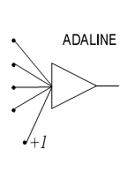
ADAPTIVE LINEAR NEURON (ADALINE)
In 1959, Bernard Widrow and Marcian Hoff of Stanford developed models they called ADALINE (Adaptive Linear Neuron) and MADALINE (Multilayer ADALINE). These models were named for their use of Multiple ADAptive LINear Elements. MADALINE was the first neural network to be applied to a real world problem. It is an adaptive filter which eliminates echoes on phone lines.

Slide 46
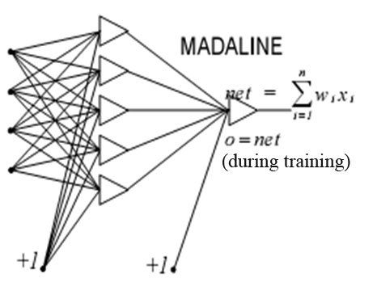
MADALINE NETWORK
MADALINE is a Multilayer Adaptive Linear Element. MADALINE was the first neural network to be applied to a real world problem. It is used in several adaptive filtering process.

Slide 47
Gradient Descent and the Widrow-Hoff learning Rule
Although the perceptron rule finds a successful weight vector when the training examples are linearly separable, it can fail to converge if the examples are not linearly separable.
ADALINE uses Adaline or Widrow-Hoff learning Rule
MADALINE uses Delta Learning rule
The key idea of the rule: to use gradient descent to search the space of possible weight vector to find the weights that best fit the training examples. This rule is important because it provides the basis for the backpropagration algorithm, which can learn networks with many interconnected units.

Slide 48
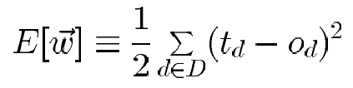
In order to derive a weight learning rule for linear units, let specify a measure for the training error of a weight vector, relative to the training examples. The Training Error can be computed as the following squared error
(2)
where D is set of training examples, t_{d} is the target output for the training example d and o_{d} is the output of the linear unit for the training example d.
Here we characterize the cost function E as a function of weight vector because the linear unit output O depends on this weight vector.

Slide 49
Hypothesis Space
To understand the gradient descent algorithm, it is helpful to visualize the entire space of possible weight vectors and their associated E values
Here the axes w_{o},w₁ represents possible values for the two weights of a simple linear unit. The w_{o},w₁ plane represents the entire hypothesis space.
The vertical axis indicates the error E relative to some fixed set of training examples. The error surface shown in the figure summarizes the desirability of every weight vector in the hypothesis space.
For linear units, this error surface must be parabolic with a single global minimum. And we desire a weight vector with this minimum.

Slide 50
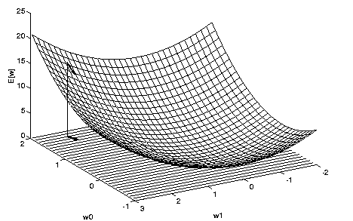
The error surface
How can we calculate the direction of steepest descent along the error surface? This direction can be found by computing the derivative of E w.r.t. each component of the vector w.

Slide 51
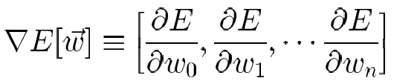

Derivation of the Gradient Descent Rule
Gradient-descent algorithm suggests adjusting each weight w_{i} by an amount Δw_{i} proportional to the negative of the gradient of E[w] at the current location, i.e. Δw∞∇E[w], i.e. Δw = η∇E[w]
This vector derivative is called the gradient of E with respect to the vector <w₀,…,w_{n}>, written ∇E .
(3)
Notice ∇E is itself a vector, whose components are the partial derivatives of E with respect to each of the w_{i}. When interpreted as a vector in weight space, the gradient specifies the direction that produces the steepest increase in E. The negative of this vector therefore gives the direction of steepest decrease.
Since the gradient specifies the direction of steepest increase of E, the training rule for gradient descent is
w ←w + Δw
where
(4)

Slide 52
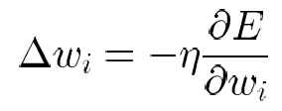
Here η is a positive constant called the learning rate, which determines the step size in the gradient descent search. The negative sign is present because we want to move the weight vector in the direction that decreases E. This training rule can also be written in its component form
w_{i} ←w_{i} + Δw_{i}
where
(5)
which makes it clear that steepest descent is achieved by altering each component w_{i} of weight vector in proportion to ∂E/∂w_{i}.
The vector of ∂E/∂w_{i} derivatives that form the gradient can be obtained by differentiating E from Equation (2), as

Slide 53
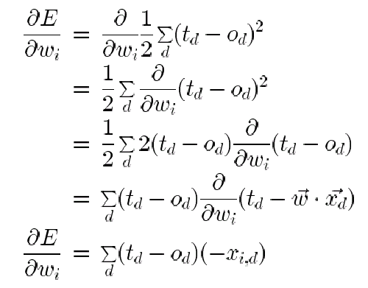
(6)
where x_{id} denotes the single input component x_{i} for the training example d. We now have an equation that gives ∂E/∂w_{i} in terms of the linear unit inputs x_{id}, output o_{d} and the target value t_{d} associated with the training example. Substituting Equation (6) into Equation (5) yields the weight update rule for gradient descent.

Slide 54
(7)
The gradient descent algorithm for training linear units is as follows: Pick an initial random weight vector. Apply the linear unit to all training examples, then compute Δw_{i} for each weight according to Equation (7). Update each weight w_{i} by adding Δw_{i} , then repeat the process.
Because the error surface contains only a single global minimum, this algorithm will converge to a weight vector with minimum error, regardless of whether the training examples are linearly separable, given a sufficiently small η is used.
If η is too large, the gradient descent search runs the risk of overstepping the minimum in the error surface rather than settling into it. For this reason, one common modification to the algorithm is to gradually reduce the value of η as the number of gradient descent steps grows.

Slide 55
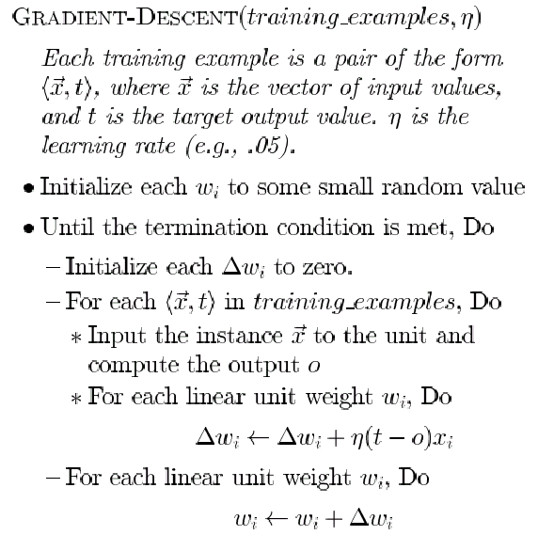
Gradient Descent algorithm for training a linear unit.

Slide 56
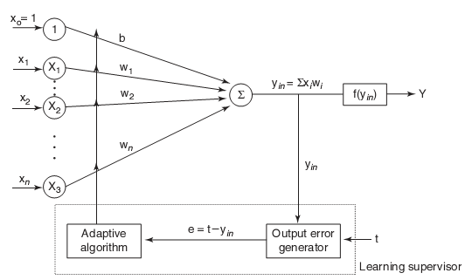
ADALINE MODEL

Slide 57
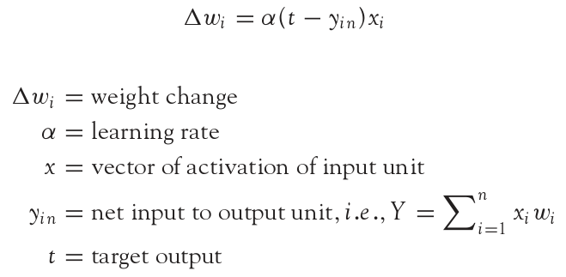
ADALINE LEARNING RULE
Adaline network uses Delta Learning Rule. This rule is also called as Widrow Learning Rule or Least Mean Square Rule. The delta rule for adjusting the weights is given as (i = 1 to n):

Slide 58
USING ADALINE NETWORKS
Initialize
Assign random weights to all links
Training
Feed-in known inputs in random sequence
Simulate the network
Compute error between the input and the output (Error Function)
Adjust weights (Learning Function)
Repeat until total error < ε
Thinking
Simulate the network
Network will respond to any input
Does not guarantee a correct solution even for trained inputs
Initialize
Training
Thinking

Slide 59
MULTILAYER PERCEPTRON
Output Values
Output Layer
Adjustable
Weights
Input Layer
Input Signals (External Stimuli)

Slide 60
LAYERS IN NEURAL NETWORK
The input layer:
Introduces input values into the network.
No activation function or other processing.
The hidden layer(s):
Performs classification of features.
Two hidden layers are sufficient to solve any problem.
Features imply more layers may be better.
The output layer:
Functionally is just like the hidden layers.
Outputs are passed on to the world outside the neural network.

Slide 61
EXAMPLE
Multi-layer
Neural Network
Hidden layer
of neurons
1,0
1,1
Logical XOR
Function
X Y Z
0 0 0
0 1 1
0 1
1 1 0
X
0,0
0,1
Y
Two neurons are need! Their combined results
can produce good classification.

Slide 62
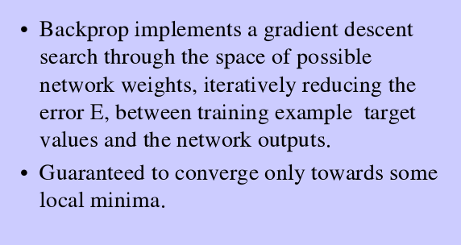
BACK PROPAGATION NETWORK

Slide 63
BACKPROPAGATION NETWORK
A training procedure which allows multilayer feedforward Neural Networks to be trained.
Can theoretically perform “any” input-output mapping.
Can learn to solve linearly inseparable problems.

Slide 64
MULTILAYER FEEDFORWARD NETWORK
Inputs
Hiddens
I₀
Outputs
h₀
I₁
o₀
h₁
I₂
o₁
h₂
Outputs
I₃
Hiddens
Inputs

Slide 65
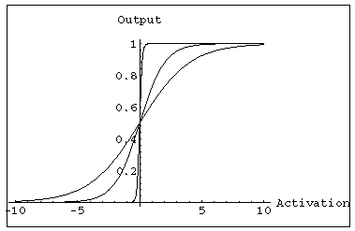
MULTILAYER FEEDFORWARD NETWORK:
ACTIVATION AND TRAINING
For feedforward networks:
A continuous function can be
differentiated allowing
gradient-descent.
Backpropagation is an example of a gradient-descent technique.
Uses sigmoid (binary or bipolar) activation function.
In multilayer networks, the activation function is usually more complex than just a threshold function, like 1/[1+exp(-x)] or even 2/[1+exp(-x)] – 1 to allow for inhibition, etc.

Slide 66
GRADIENT DESCENT
Gradient-Descent(training_examples, η)
Each training example is a pair of the form <(x1,…xn),t> where (x1,…,xn) is the vector of input values, and t is the target output value, η is the learning rate (e.g. 0.1)
Initialize each wi to some small random value
Until the termination condition is met, Do
Initialize each Δwi to zero
For each <(x1,…xn),t> in training_examples Do
Input the instance (x1,…,xn) to the linear unit and compute the output o
For each linear unit weight wi Do
Δwi= Δwi + η (t-o) xi
For each linear unit weight wi Do
wi=wi+Δwi

Slide 67
MODES OF GRADIENT DESCENT
Batch mode : gradient descent
w=w - η ∇ED[w] over the entire data D
ED[w]=1/2Σd(td-od)2
Incremental mode: gradient descent
w=w - η ∇Ed[w] over individual training examples d
Ed[w]=1/2 (td-od)2
Incremental Gradient Descent can approximate Batch Gradient Descent arbitrarily closely if η is small enough.

Slide 68
SIGMOID ACTIVATION FUNCTION
x₀₌₁
x₁
w₁
w₀
net=Σ_{i=0}^{n} w_{i} x_{i}
o=σ(net)=1/(1+e^{-net})
w₂
x₂
Σ
o
.
.
.
w_{n}
σ(x) is the sigmoid function: 1/(1+e^{-x)}
dσ(x)/dx= σ(x) (1- σ(x))
x_{n}
Derive gradient decent rules to train:
one sigmoid function
∂E/∂w_{i} = -Σ_{d}(t_{d}-o_{d}) o_{d} (1-o_{d}) x_{i}
Multilayer networks of sigmoid units backpropagation

Slide 69
BACKPROPAGATION TRAINING ALGORITHM
Initialize each wi to some small random value.
Until the termination condition is met, Do
For each training example <(x1,…xn),t> Do
Input the instance (x1,…,xn) to the network and compute the network outputs ok
For each output unit k
δk=ok(1-ok)(tk-ok)
For each hidden unit h
δh=oh(1-oh) Σk wh,k δk
For each network weight w,j Do
wi,j=wi,j+Δwi,j where
Δwi,j= η δj xi,j

Slide 70
BACKPROPAGATION
Gradient descent over entire network weight vector
Easily generalized to arbitrary directed graphs
Will find a local, not necessarily global error minimum
-in practice often works well (can be invoked multiple times with different initial weights)
Often include weight momentum term
Δwi,j(t)= η δj xi,j + α Δwi,j (t-1)
Minimizes error training examples
Will it generalize well to unseen instances (over-fitting)?
Training can be slow typical 1000-10000 iterations
(use Levenberg-Marquardt instead of gradient descent)

Slide 71
APPLICATIONS OF BACKPROPAGATION
NETWORK
Load forecasting problems in power systems.
Image processing.
Fault diagnosis and fault detection.
Gesture recognition, speech recognition.
Signature verification.
Bioinformatics.
Structural engineering design (civil).

Slide 72
Solving XOR problem using the simplest network

Slide 73
Solving XOR problem using the simplest network
# | Inputs |  | Neuron 1 |  | Neuron 2 |  | Neuron 3 |  | XOR=
 |  |  | Z | output | Z | output | Z | output
1) | 1 | 1 | 1 | 1 | 5 | 1 | 5 | 1 | 1
2) | 1 | -1 | -5 | -1 | 7 | 1 | -1 | -1 | -1
3) | -1 | 1 | 7 | 1 | -1 | -1 | -1 | -1 | -1
4) | -1 | -1 | 1 | 1 | 1 | 1 | 5 | 1 | 1

Slide 74
Threshold Functions and Threshold Neurons
Threshold (linearly separable) functions can be learned by a single threshold neuron
Non-threshold (nonlinearly separable) functions can not be learned by a single neuron. For learning of these functions a neural network created from threshold neurons is required (Minsky-Papert, 1969)
The number of all Boolean functions of n variables is equal to , but the number of the threshold ones is substantially smaller. Really, for n=2 fourteen from sixteen functions (excepting XOR and not XOR) are threshold, for n=3 there are 104 threshold functions from 256, but for n>3 the following correspondence is true (T is a number of threshold functions of n variables):
For example, for n=4 there are only about 2000 threshold functions from 65536

Slide 75
Is it possible to learn XOR, Parity n and other non-linearly separable functions using a single neuron?
Any classical monograph/text book on neural networks claims that to learn the XOR function a network from at least three neurons is needed.
This is true for the real-valued neurons and real-valued neural networks.
However, this is not true for the complex-valued neurons !!!
A jump to the complex domain is a right way to overcome the Misky-Papert’s limitation and to learn multiple-valued and Boolean nonlinearly separable functions using a single neuron.

Slide 76
XOR problem
n=2, m=4 – four sectors
W=(0, 1, i) – the weighting vector
i
-1
1
-i

Slide 77
Blurred Image Restoration (Deblurring) and Blur Identification by MLMVN

Slide 78
Blurred Image Restoration (Deblurring) and Blur Identification by MLMVN
I. Aizenberg, D. Paliy, J. Zurada, and J. Astola, "Blur Identification by Multilayer Neural Network based on Multi-Valued Neurons", IEEE Transactions on Neural Networks, vol. 19, No 5, May 2008, pp. 883-898.

Slide 79


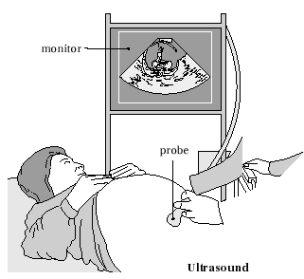
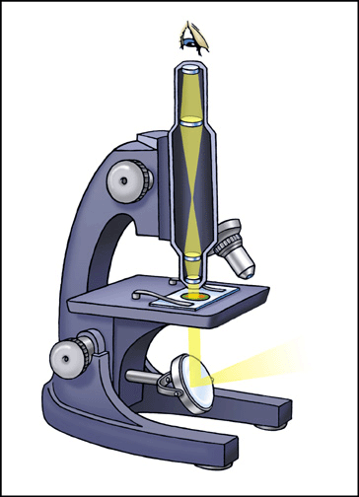
Problem statement: capturing
Mathematically a variety of capturing principles can be described by the Fredholm integral of the first kind
where x,t ℝ², v(t) is a point-spread function (PSF) of a system, y(t) is a function of a real object and z(x) is an observed signal.
Photo
Tomography
Microscopy

Slide 80
Image deblurring: problem statement
Mathematically blur is caused by the convolution of an image with the distorting kernel.
Thus, removal of the blur is reduced to the deconvolution.
Deconvolution is an ill-posed problem, which results in the instability of a solution. The best way to solve it is to use some regularization technique.
To use any kind of regularization technique, it is absolutely necessary to know the distorting kernel corresponding to a particular blur: so it is necessary to identify the blur.

Slide 81
Blur Identification
We use multilayer neural network based on multi-valued neurons (MLMVN) to recognize Gaussian, motion and rectangular (boxcar) blurs.
We aim to identify simultaneously both blur and its parameters using a single neural network.

Slide 82
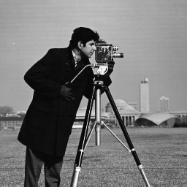




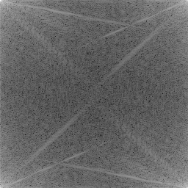
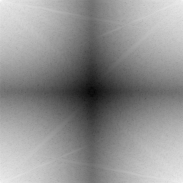
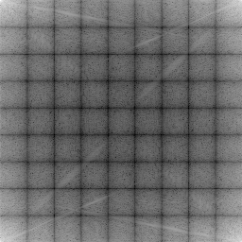
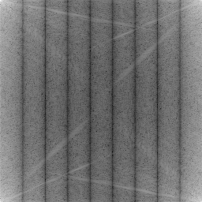
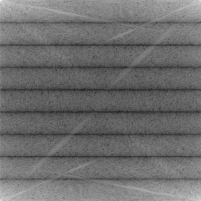
Degradation in the frequency domain:
True Image
Gaussian
Rectangular
Horizontal
Motion
Vertical
Motion
Images and log of their Power Spectra

Slide 83
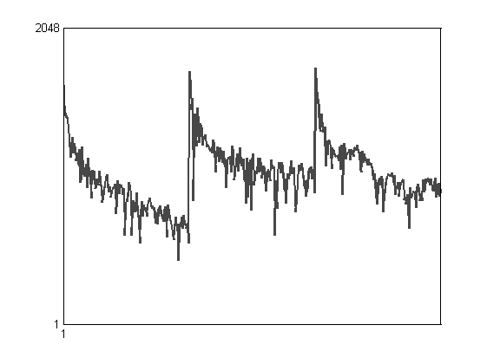
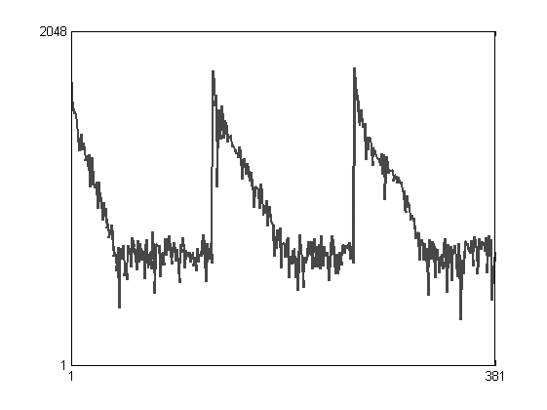
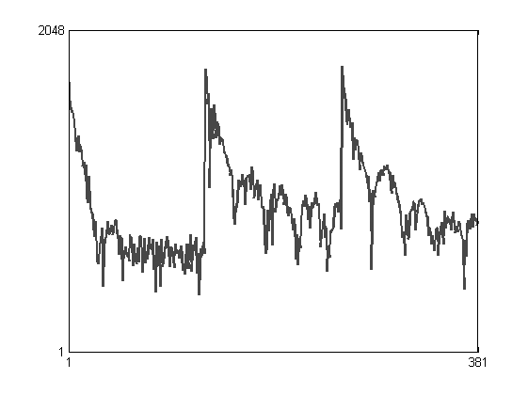
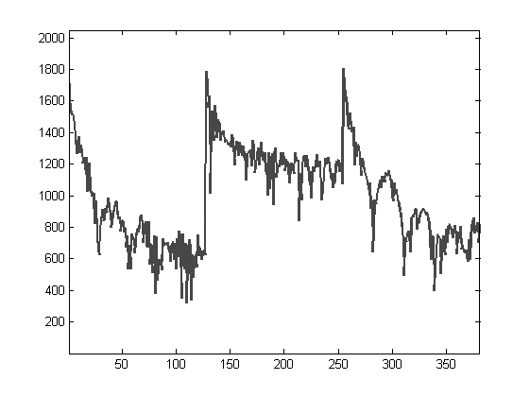
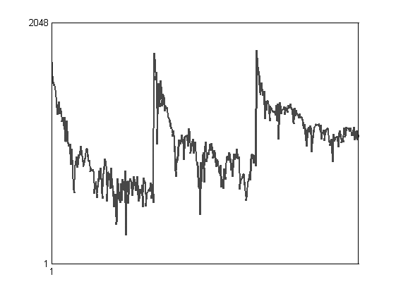
Examples of training vectors
True Image
Gaussian
Rectangular
Horizontal
Motion
Vertical
Motion

Slide 84
Neural Network 5→35→6
Training (pattern) vectors
1
Blur 1
2
Blur 2
n
Blur N
Hidden layers Output layer

Slide 85
Simulation
Experiment 1 (2700 training pattern vectors corresponding to 72 images): six types of blur with the following parameters:
MLMVN structure: 5→35→6
1) The Gaussian blur is considered with
2) The linear uniform horizontal motion blur of the lengths 3, 5, 7, 9;
3) The linear uniform vertical motion blur of the length 3, 5, 7, 9;
4) The linear uniform diagonal motion from South-West to North- East blur of the lengths 3, 5, 7, 9;
5) The linear uniform diagonal motion from South-East to North- West blur of the lengths 3, 5, 7, 9;
6) rectangular has sizes 3x3, 5x5, 7x7, 9x9.

Slide 86
Results
Classification Results
Blur | MLMVN, 381 inputs, 5→35→6, 2336 weights in total | SVM Ensemble from 27 binary decision SVMs, 25.717.500 support vectors in total
No blur | 96.0% | 100.0%
Gaussian | 99.0% | 99.4%
Rectangular | 99.0% | 96.4
Motion horizontal | 98.5% | 96.4
Motion vertical | 98.3% | 96.4
Motion North-East Diagonal | 97.9% | 96.5
Motion North-West Diagonal | 97.2% | 96.5

Slide 87




Restored images
Blurred noisy image:
rectangular 9x9
Blurred noisy image:
Gaussian, σ=2
Restored
Restored

